Slide 1
Celebrity faces Deep Fake Detection
Boya yashasvi naidu M SAI SADEEP
210962070 210962072

Slide 2
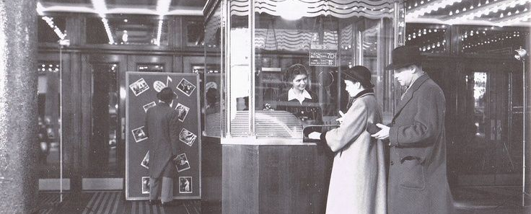
INTRODUCTION:

Slide 3
Technology has made it easy for anyone to manipulate digital media, from simple photo edits to hyper-realistic deepfake videos.
While this has led to fun applications like FaceApp, it also raises concerns about misuse.
Deepfake tools can create convincing but fake videos, leading to issues like fake celebrity videos and spreading misinformation.
To address this, our research focuses on detecting deepfakes using advanced neural networks.
We want to protect digital integrity and restore trust in online content

Slide 4
Objectives:
Develop a deepfake detection model integrating spatial and temporal information from video frames using ResNext CNN for feature extraction and LSTM for sequential analysis.
Classify videos as deepfake or authentic by identifying subtle traces and distinct artifacts indicative of the deepfake generation process.
Evaluate the proposed methodology on a diverse dataset containing both real and deepfake videos, striving for high accuracy with low false positive and false negative rates.
Compare the performance of the developed model against baseline methods and assess its reliability across different real-world scenarios to demonstrate its effectiveness in combating deepfake proliferation.

Slide 5
Literature Review:
[1]The paper introduces a new method for detecting deepfake videos by analyzing video sequences' temporal structure using optical flow fields, capturing motion discrepancies between natural and synthetic videos. Optical flow fields, computed with PWC-Net, represent motion between frames and are fed into a semi-trainable CNN (e.g., VGG16 or ResNet50) for classification. Transfer learning is used due to limited data, fine-tuning part of the network on deepfake data while leveraging pre-existing features. Initial results on FaceForensics++ show promise, with plans for future research on optical flow field reliability across datasets and neural network architectures, and potential integration with frame-based detection methods for improved accuracy.
Limitation: Dependency on Optical Flow Accuracy: The effectiveness of the method heavily relies on the accuracy of optical flow field estimation using PWC-Net. Inaccuracies in optical flow estimation could lead to misinterpretation of motion patterns, impacting the overall detection performance.

Slide 6
[2]The study presents DeepVision, an algorithm designed for Deepfake detection by analyzing eye blinking patterns influenced by gender, age, activity, and time. DeepVision utilizes Fast-HyperFace and EAR algorithms for face and eye detection, respectively, to track changes in blinking behavior. By comparing measured data with a database, DeepVision achieves an impressive 87.5% accuracy rate in identifying Deepfakes. However, limitations arise from mental illnesses that can affect blinking patterns, potentially impacting detection accuracy. Despite these challenges, DeepVision represents a promising approach to enhancing integrity verification and combatting the spread of Deepfakes, leveraging nuanced behavioral cues for more effective detection.
Limitation: A notable limitation highlighted in the study is the influence of mental illnesses on blinking patterns. Conditions affecting cognitive or behavioral aspects may lead to atypical blinking behaviors, potentially affecting the accuracy of DeepVision’s detection capabilities.

Slide 7
[3] This paper presents a novel method for detecting Deep Fakes by analyzing discrepancies in estimated head poses from facial landmarks. Deep Fakes replace parts of original images with synthetic faces, causing inconsistencies in landmark positions. The approach compares head poses derived from central face regions and entire faces to identify these mismatches, using SVM classifiers trained on the differences to distinguish real from Deep Fake images/videos. Experimental results across various datasets demonstrate high classification accuracy. The study emphasizes the potential of leveraging 3D head pose estimation as a reliable cue for detecting AI-generated fake content, contributing to efforts against misinformation and digital impersonations.
Limitation: Dependency on accurate landmark detection and reliable head pose estimation. Inaccuracies or errors in landmark localization and pose estimation could lead to false detections or reduced effectiveness in distinguishing between real and Deep Fake images/videos.

Slide 8
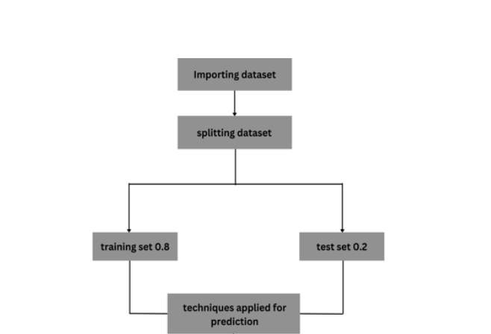
Methodology:
The overall methodology as was followed is shown in the block diagram.
The dataset is first imported
It is then preprocessed as seen fit to be fed into a model
The data is explored to identify the relationships between various attributes.
The models are then trained, and the best performing model is selected.

Slide 9
A. Creating Deepfakes:
Deepfake creation involves using tools like GANs (Generative Adversarial Networks) and autoencoders, which combine a source image and target video to replace faces in frames.
Videos are broken down into frames, and faces are identified within each frame for modification.
Source faces are replaced with target faces, and the modified frames are merged using pre-trained models to enhance video quality and eliminate residual artifacts.
Deepfake videos, despite appearing realistic, often contain subtle traces or artifacts left behind by the generation process.
The research aims to detect these imperceptible traces and distinct artifacts to accurately classify videos as either deepfake or authentic, leveraging insights into the deepfake creation process.

Slide 10
B. Data Acquisition and Preprocessing:
Gathered data from various datasets including FaceForensic++ (FF), Deepfake Detection Challenge (DFDC), and Celeb-DF to create a new dataset for efficient real-time deepfake detection.
Ensured a balanced dataset with 50% real and 50% fake videos to avoid training bias in the model.
Preprocessed the DFDC dataset by removing audio-altered videos using a Python script, focusing solely on visual deepfake detection for this research.
Selected specific numbers of videos from each dataset: 1500 real and 1500 fake videos from DFDC, 1000 real and 1000 fake videos from FF, and 500 real and 500 fake videos from Celeb-DF, resulting in a total dataset of 3000 real and 3000 fake videos, totaling 6000 videos overall.
Used this diverse dataset to train and evaluate the deepfake detection model, aiming for accurate and real-time detection across different types of video content.

Slide 11
C. Model Architecture:
Our model employs a combination of Convolutional Neural Network (CNN) and Recurrent Neural Network (RNN), specifically Long Short-Term Memory (LSTM), for video classification tasks such as identifying deepfake versus pristine videos.
ResNext Feature Extraction: To extract frame-level features, we utilize a pre-trained ResNext CNN model. ResNext is a variant of the Residual CNN architecture optimized for deep neural networks. For our experiments, we leverage the `resnext50_32x4d` model, which consists of 50 layers and dimensions of 32 x 4.
Fine-tuning with Additional Layers: Instead of building the CNN from scratch, we fine-tune the pre-trained ResNext model by adding additional layers tailored to our classification task. These layers are adjusted to ensure proper convergence during gradient descent, including selecting an appropriate learning rate.

Slide 12
LSTM for Sequence Processing: The 2048-dimensional feature vectors extracted by the ResNext model serve as input to the LSTM network. We use a single-layer LSTM with 2048 latent dimensions and 2048 hidden units, incorporating a dropout probability of 0.4 to prevent overfitting. The LSTM processes frames sequentially, allowing for temporal analysis by comparing frames at different time steps within the video.
Activation Functions and Output Layer: The model includes a Leaky ReLU activation function for non-linearity. A linear layer with 2048 input features and 2 output features (for binary classification) enables the model to learn correlations between input and output. An adaptive average pooling layer with an output size of 1 is used to reshape the data for downstream processing.
Batch Training and SoftMax Layer: Training is performed in batches of size 4 to optimize efficiency. A SoftMax layer is employed to compute class probabilities during prediction, providing a confidence score for the model's output.

Slide 13
D. Hyperparameter Tuning:
Hyperparameter tuning was conducted using the Adam optimizer with a learning rate of 1e-3 (0.001) and a weight decay of 1e-3 to optimize model convergence during training.
The cross-entropy loss function was employed for this classification problem to measure model performance.
Batch training was utilized with a batch size of 4, determined through experimentation to balance training efficiency and resource utilization in the development environment.

Slide 14
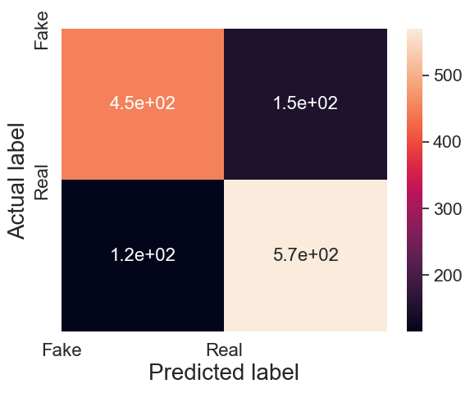
DISCUSSION AND ANALYSIS OF RESULTS:
True positive = 450
False positive = 151
False negative = 115
True negative = 570
Precision is the ratio of correctly classified real images (true positives) to the total number of images classified as real (true positives + false positives). In this case, the model is precise about 75% of the time it predicts a real image.
Recall is the ratio of correctly classified real images (true positives) to the total number of actual real images (true positives + false negatives). Here, the model correctly identifies nearly 80% of the real images.

Slide 15
CONCLUSION:
The proposed model, combining feature extraction from a pre-trained ResNext CNN model with sequential analysis via LSTM, was evaluated on a dataset comprising 3000 real videos and 3000 deepfake videos. The model achieved an overall accuracy of 79.315% on the task of classifying videos as either deepfake or authentic.

Slide 16
References:
[1]. Xin Yang, Seoungwon, Jinsub Yoon, and Hyoungseob Kim. ” DeepVision: Deepfakes Detection Using Human Eye Blinking Pattern International Journal of Electrical and Computer Engineering (IJECE) Vol. 9, No. 5, pp. 1207 1212, September 2019.
[2]. Irene Amerini, Roberta Marzario, Domenico Vitulano, Silvia Ruggeri, Matteo Barni Hyoungseob Kim. ” Deepfake Video Detection through Optical Flow Based CNN: 2019 IEEE International Conference on Computer Vision Workshop (ICCVW)
[3]. Yang, X., Li, Y., & Lyu, S. (2019). Exposing deep fakes using inconsistent head poses. In 2019 IEEE International Conference on Acoustics, Speech and Signal Processing (ICASSP) (pp. 8261-8265). IEEE.

